Slide 1
Information Privacy
KT44102/3
Ethics and Law in ICT
Sem 1: 2021/2020
23 November 2021

Slide 2
Contents
Introduction
Privacy and Trust
Information Disclosure
Key Privacy & Anonymity Issues

Slide 3
Introduction: Information Technology Erodes Privacy
Collection, exchange, combination, and distribution of information easier than ever, lessens privacy
Scott McNealy: “You have zero privacy anyway. Get over it.”
We will consider how we leave an “electronic trail” of information behind us and what others can do with this info

Slide 4
Perspectives: Definition
Privacy related to notion of access
Access
Physical proximity to a person
Knowledge about a person
Privacy is a “zone of inaccessibility”
Privacy violations are an offend to human dignity
Too much individual privacy can harm society
Where to draw the line?

Slide 5
Perspectives: Definition
“The right to be left alone—the most comprehensive of rights, and the right most valued by a free people”
Information privacy is a combination of:
Communications privacy
Ability to communicate with others without being monitored by other persons or organizations
Data Privacy
Ability to limit access to one’s personal data by other individuals and organizations in order to exercise a substantial degree of control over that data and its use

Slide 6
Perspective: Related Activities Categories
Information Collection
Activities that gather personal information includes information collection by the government.
Information Processing
Activities that store, manipulate and use personal information that has been collected.
Information Dissemination
Activities that spread personal information
Invasion
Activities that intrude upon a person’s daily life, interrupt a person's solitude, or interfere with someone’s decision marking.

Slide 7
Perspective: Harms & Benefits
Harms
Cover for illegal or immoral activities
Burden on the nuclear family
Hidden dysfunctional families
Ignored people on society’s fringes
Benefits
Individual growth
Individual responsibility
Freedom to be yourself
Intellectual and spiritual growth
Development of loving, trusting, caring, intimate relationships

Slide 8
Perspective: Natural Right?
Privacy rights stem from property rights: “a man’s home is his castle”
Samuel Warren and Louis Brandeis: People have “the right to be let alone”
Judith Jarvis Thomson: “Privacy rights” overlap other rights
Conclusion: Privacy is not a natural right, but it is a prudential right

Slide 9
Privacy and Trust
Perhaps modern life is more private than life centuries ago
Most people don’t live with extended families
Automobile allows us to travel alone
Television v. public entertainment
Challenge: we now live among strangers
Remedy: establishing reputations
Ordeal, such as lie detector test or drug test
Credential, such as driver’s license, key, ID card, college degree
Establishing reputation is done at the cost of reducing privacy

Slide 10
Information Disclosures
Public record: information for public access
E.g.: birth certificates, marriage licenses
Public information: information revealed to an organization that has right to share it
E.g.: Purchases information
Personal information: undisclosed information
Types of disclosures
Voluntary - e.g: Providing own information to participate in contest
Involuntary – e.g.: Facebook tag: Tagging the private account without permission
Statutory – Must provide information because of involve with the law/ Statutory

Slide 11
Information Disclosures

Slide 12
Information Disclosures: Ways Information Becomes Public
Facebook tags - Does this feature increase risk of improper tagging?
Enhanced 911 services - What if this information is sold or shared?
Rewards or loyalty programs - Do card users pay less, or do non-users get overcharged?
Body scanners -
RFID tags
Implanted chips
Automobile “black boxes”
Medical records
Digital video recorders
Cookies and flash cookies

Slide 13
Key Privacy and Anonymity Issues
Identity theft
Electronic discovery
Consumer profiling
Data Mining
Treating customer data responsibly
Workplace monitoring
Government surveillance
Advance surveillance technology

Slide 14
1. Identity Theft
4 approaches used by identity thieves
Create a data breach
To gain personal identity information
May be caused by (hackers &failure to follow proper security procedures)
Purchase personal data
Back market – i.e., credit card, logon on name and PIN for bank account, Identity information
Use phishing to entice users to give up date
Through a counterfeit Web site
Install spyware to capture keystrokes of victims
Keystoker-logging software
Capture: i.e., Account usernames, passwords, Credits card number..
Operates even if infected computer is not online.

Slide 15
Electronic Discovery
Raises many ethical issues
Should an organization attempt to destroy or conceal incriminating evidence?
To what degree must an organization be proactive and through in providing evidence?
Should an organization attempt to “bury” incriminating evidence in a mountain of trivial, routine data?

Slide 16
Consumer Profiling
Companies openly collect personal information about Internet users
Cookies : Text files that a Website can download to visitors’ hard drives so that it can identify visitors later.
Tracking software analyze browsing habits
Aggregating consumer data (consumer behavior & affiliate websites)
Collecting data from website visits (customized services)
Type of data (GET, POST and Click-stream data)

Slide 17
Data Mining
Searching records in one or more databases, looking for patterns or relationships
Way to generate new information using secondary information
Can be used to create profiles of individuals
Allows companies to build more personal relationships with customers

Slide 18
Data Mining
Who controls transaction information?
Buyer?
Seller?
Both?
Opt-in: Consumer must explicitly give permission before the organization can share info
Opt-out: Organization can share info until consumer explicitly forbid it
Opt-in is a barrier for new businesses, so direct marketing organizations prefer opt-out

Slide 19
Consumer Profiling
4 ways to limit/stop the deposit of cookies on hard drives
Set the browser to limit/stop cookies
Manually delete them from the hard drive
Download and install a cookies-management program
Use anonymous browsing program that don’t accept cookies

Slide 20
Treating Consumer Data Responsibly
Strong measures are required to avoid customer relationship problem
Companies should adopt: privacy guidelines
The important data to understand of data privacy policies and initiative for inside ant outside country

Slide 21
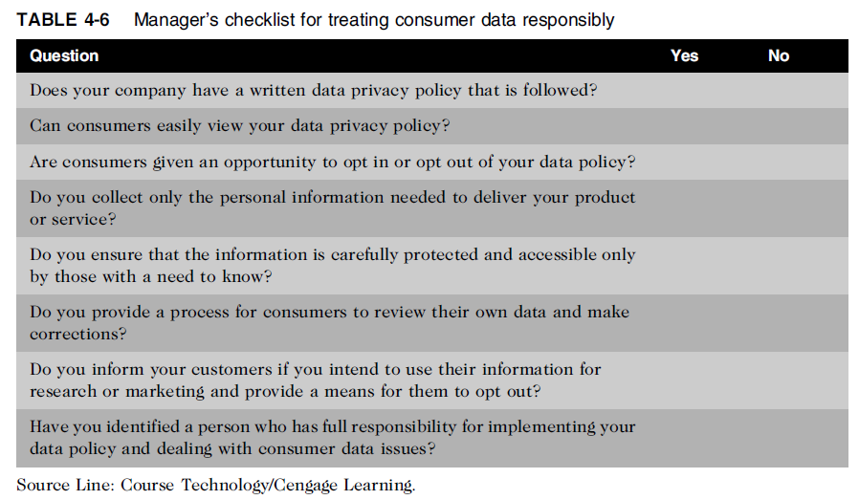
Treating Consumer Data Responsibly

Slide 22
Workplace Monitoring
Employers monitor workers:
Protect against employee abuses that reduce worker productivity or expose employer to harassment lawsuits
Privacy advocates want federal legislation
To keep employers from infringing upon privacy rights of employees

Slide 23
Government Surveillance
“The right of the people to be secure in their persons, houses, papers, and effects, against unreasonable searches and seizures, shall not be violated, and no Warrants shall issue, but upon probable cause, supported by Oath or affirmation, and particularly describing the place to be searched, and the persons or things to be seized.”

Slide 24
Government Surveillance
Wiretaps and Bugs
Surveillance System – monitored Internet traffics, including email exchange
911 case – Intercept international phone calls & email (no search warrant required)

Slide 25
Advanced Surveillance Technology
Camera surveillance
Many cities plan to expand surveillance systems
Advocates argue people have no expectation of privacy in a public place
Critics concerned about potential for abuse
Global positioning system (GPS) chips
Placed in many devices to locate user (consumer location)

